Slide 1
Blackbaud Developer Conference
Arnie Matson
Sr Director IT
Ducks Unlimited

Slide 2
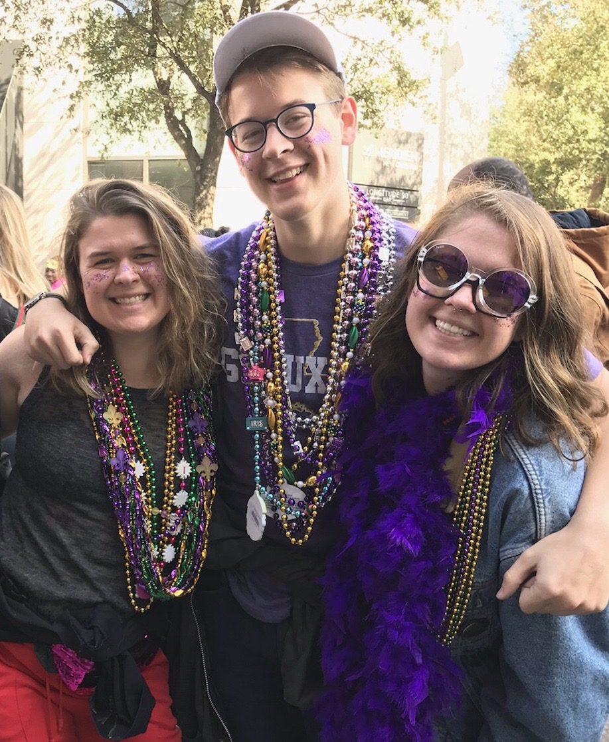
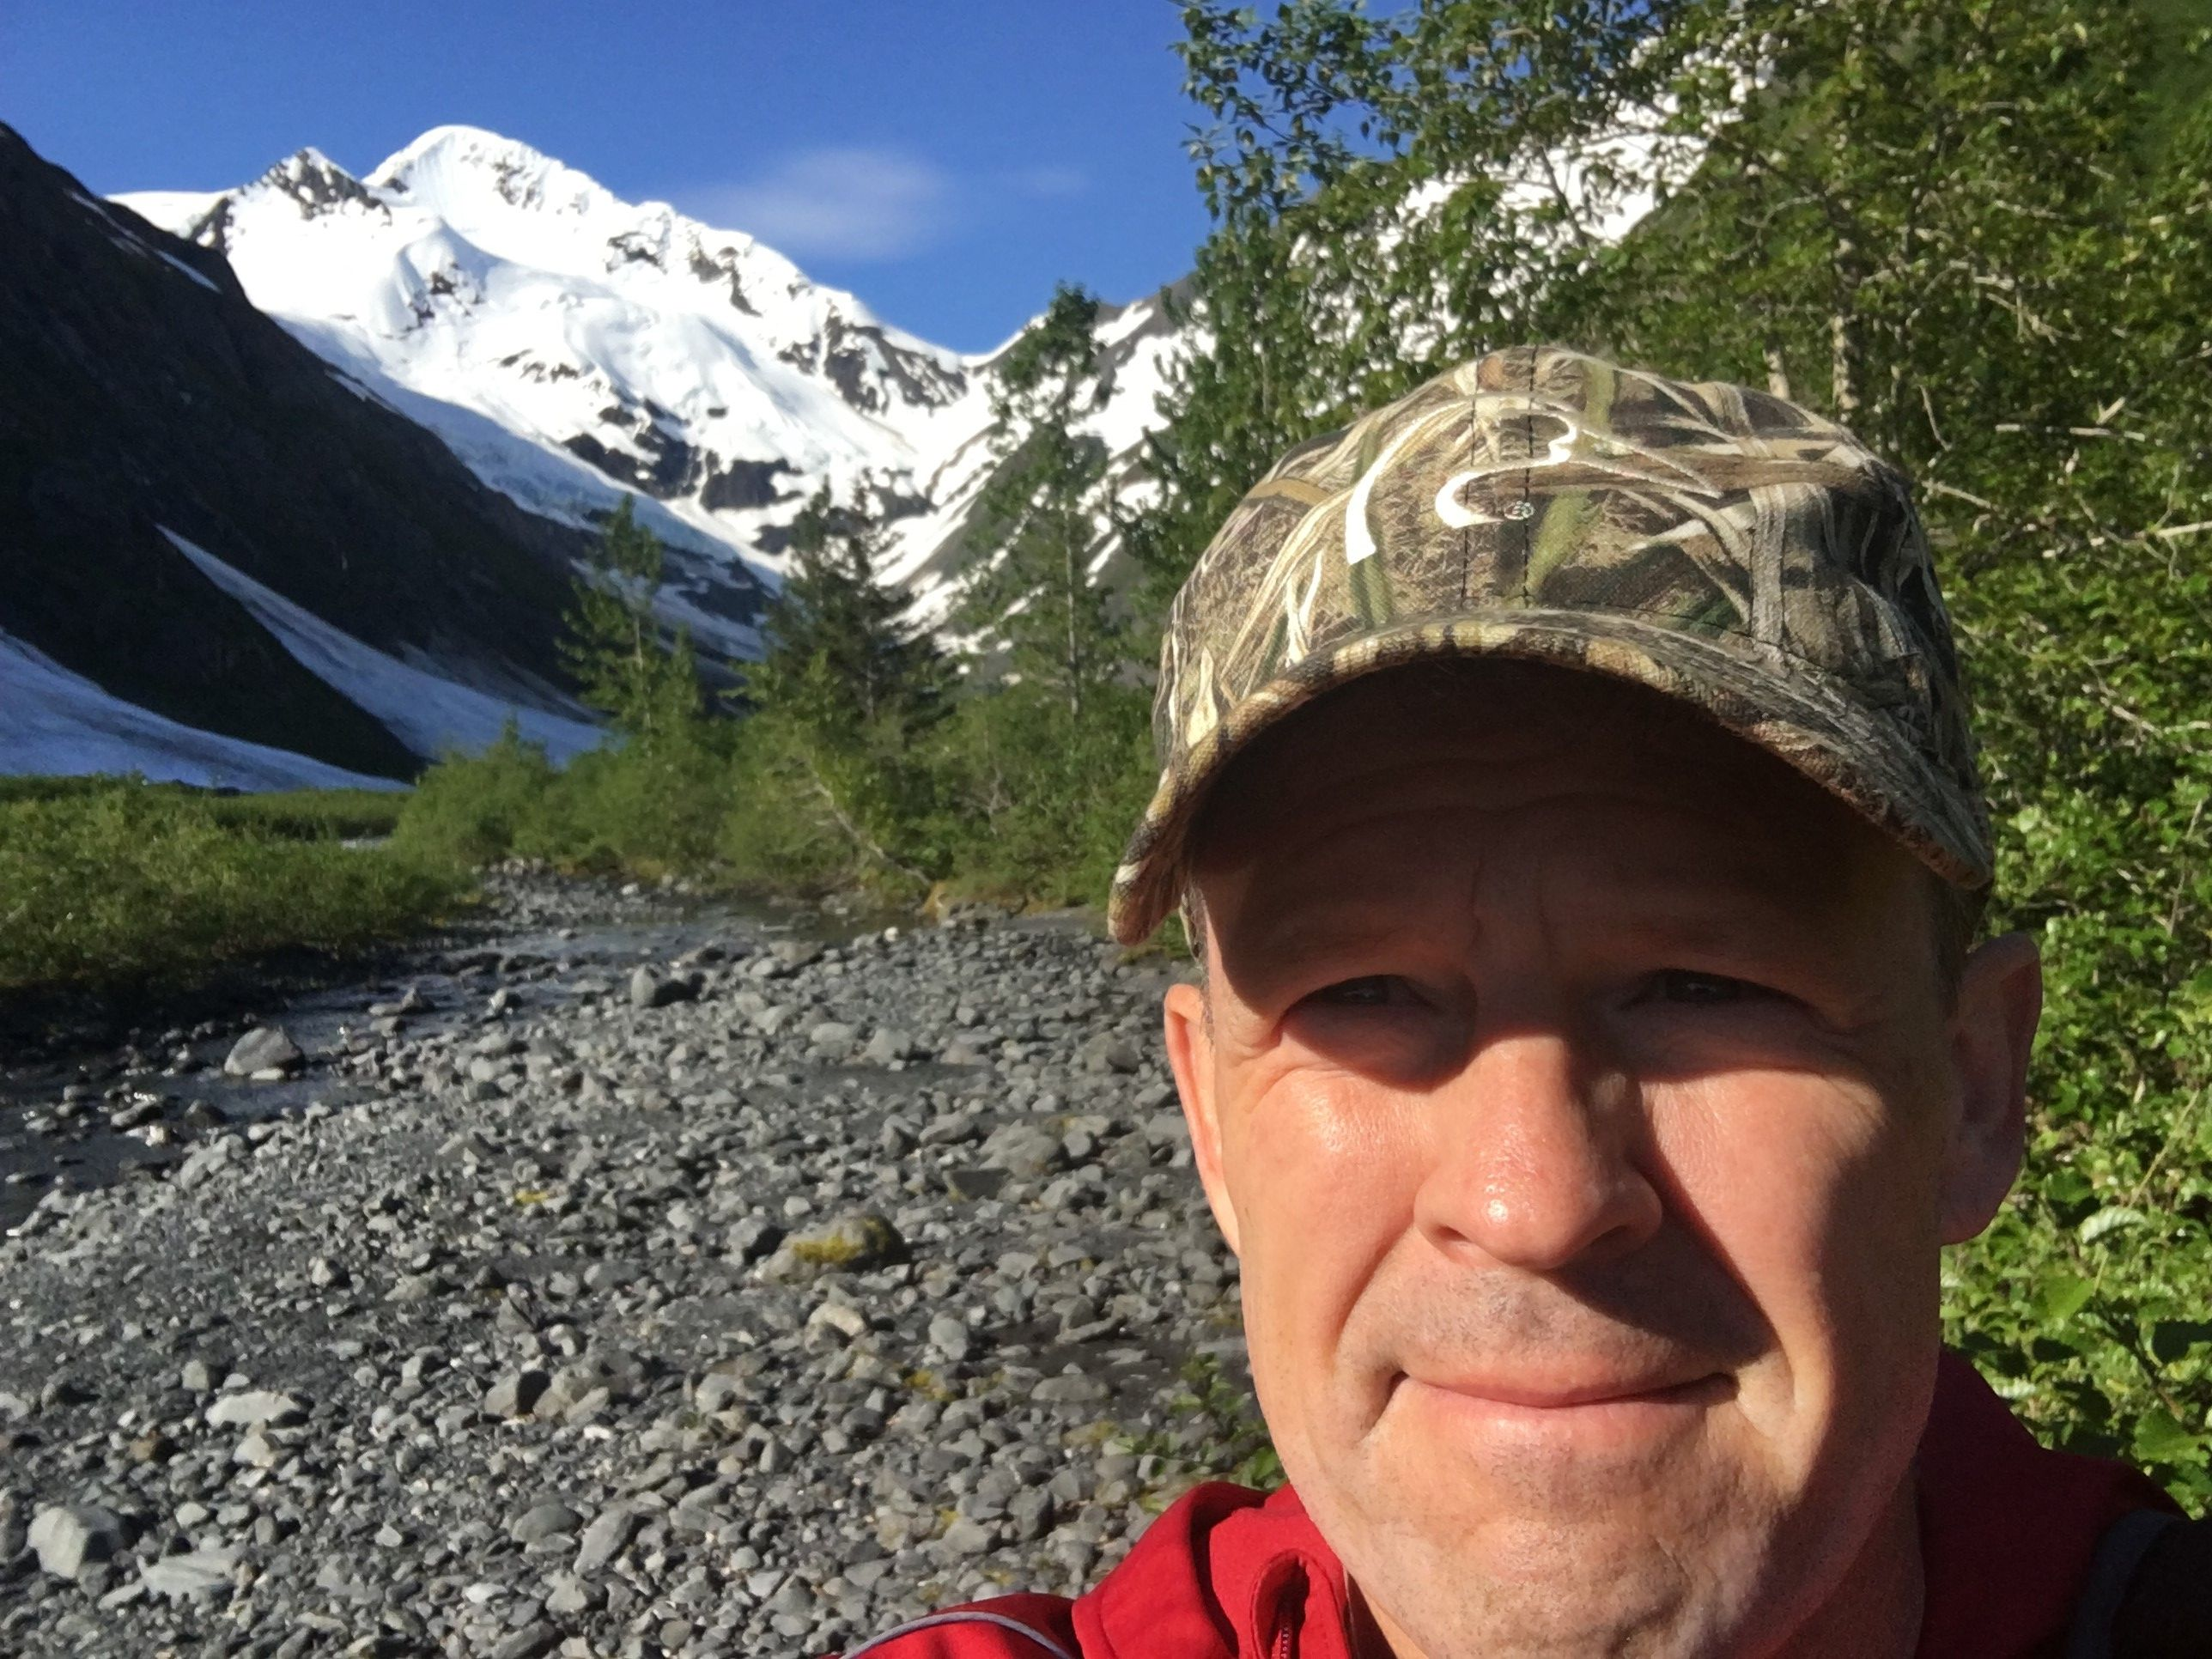
About Arnie
5 Years at Ducks Unlimited
24 Years at FedEx
Enjoy Visiting New Orleans
Enjoy the Outdoors and Spending Time with Family

Slide 3
Agenda
Challenge I – Event Creation and Promotion
The Event Ecosystem
Event Sequence and Demo
Challenge II – Events in D365 F&O

Slide 4
The Challenge Part I - Creating/Promoting Events
DU [Typically] Holds over 6,000 Fundraising Events a Year
Supported by 90+ Regional Directors Based Across the Country
Event Capabilities in BBCRM/BBIS Not Conducive to the Volume or Diversity of Users
Engaged third party platform partner -- Eventgroove -- for Enterprise Event Management, Fundraising, and Products (Eventgroove Information in Appendix)
Event Promotion is also Critical with the Ability to Communicate to:
Past Attendees
Members of a Chapter
Members in a State

Slide 5
The Event Ecosystem
D365
Finance and Operation
LogicApps
DU API
Gateway
Eventgroove -
Event Platform & Private Label
Ducks.org
Website
BBCRM
(Azure)
Eventgroove
Marketing, Registration/ Ticketing
eMail Provider

Slide 6
EventGroove to BBCRM - REST Sequence
Key DU Fundamental
Event Lookup ID = Event Appeal Name
GET Site – To Get the Event Chapter GUID
POST Event – Finite Set of Items + Value from #1
GET Event by GUID – To Get Event Lookup ID with GUID from #2
POST APPEAL – Appeal Name is Event Lookup ID from #3
PUT APPEAL – Link the Appeal to the Event
Ticket Options and Venues Managed in Eventgroove

Slide 7
Example and Demo
{
"function": "create",
"chapterLookupId": "ID-0004",
"eventLookupID":"",
"name": “Snake River Spring Event",
"startdate": "2020-03-08T18:00:00",
"enddate": "2020-03-08T22:30:00",
"capacity":300,
"category":"Dinner or Banquet",
}
{
"function": "update",
"EventLookupId": "EVT-10202876",
"name": “Snake River Winter Event",
"startdate": "2020-11-22T18:00:00",
"enddate": "2020-11-22T22:30:00",
"category":"Dinner or Banquet",
"capacity":333
}

Slide 8
Shout Out and Future Opportunities
Great Support by Patton and Team During our Event Development
PUT Event
Linking Appeal to Event
Manage Credentials via REST
Reset Expired Passwords via API
Subscription Key Management
Desire is to Assign A Key Per Interface Versus BBCRM Instance
“Wake Up” Time on REST – 1st Transaction is 5x Longer

Slide 9
The Challenge Part II – D365
Events are Required in Dynamics 365
Event Merchandise Ordering
Events are Projects in D365
Event Merchandise Sourced from Memphis
In Legacy System: Events are Batched Up Weekly for Upload into D365
Both New and Updated Events are Required in D365
Requirement: A Zero Human Intervention

Slide 10
The Components
BBCRM Custom Data Lists
Events
Chapters
G/L
LogicApp
KeyVault
D365 F&O Data Management
Custom Development in D365

Slide 11
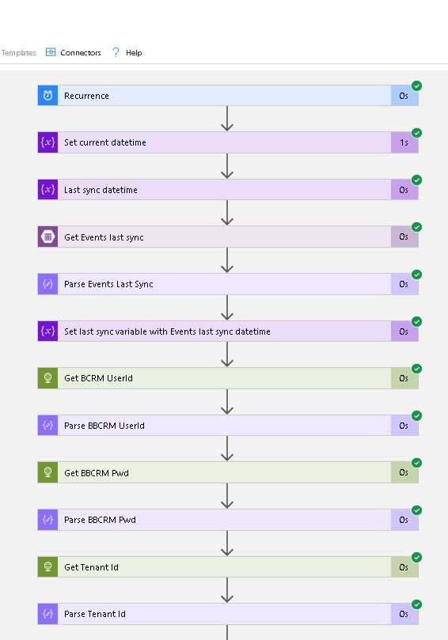
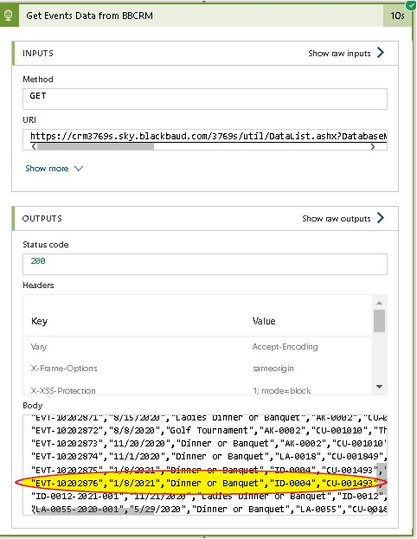
LogicApp

Slide 12
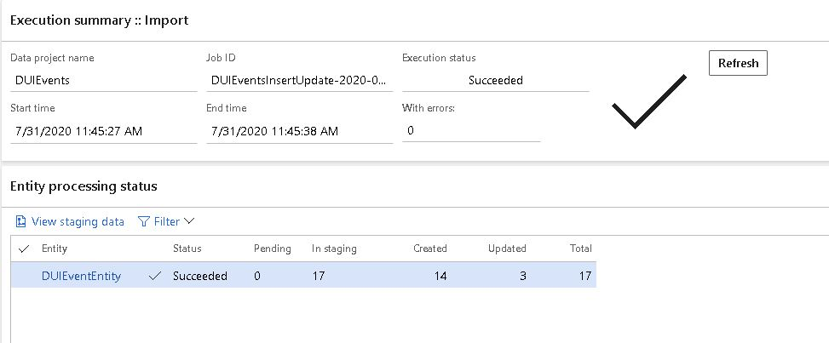
D365 Finance and Operations

Slide 13
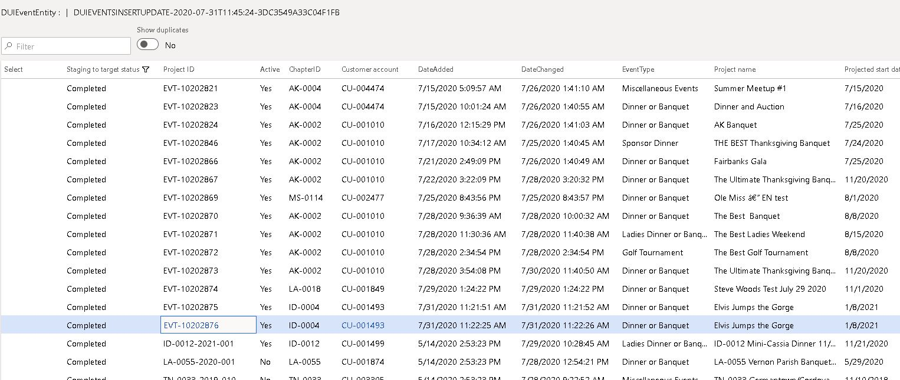
D365 Finance and Operations

Slide 14
Summary and Close Out

Slide 15




The Event & Fundraising Cycle
Eventgroove focused on helping enterprise customers have more efficient and more successful events and fundraisers – in-person, virtual, or hybrid.
Set up event
Market event
Ticket sales & registration
Distribute tickets
Execute event
Ancillary sales
Reporting and admin.
Offline
Promote event via social media, email marketing
Online advertising
Online ticket sales via website (desktop & mobile)
Upsell buyers with merchandise
Distribute e-tickets (scanable or print-at-home)
Ticket sales at event using website
Mobile check-in app
Online merchandise sales
Advertising, sponsorships & endorsements
Volunteers
One-stop integrated platform for events & fundraising
Custom E-commerce
Event Management
Fundraising
Online
Event/Fundraising products
Merch
Event Platform & Private Label
Marketing, Registration/Ticketing
Fundraising
Solutions

Slide 16

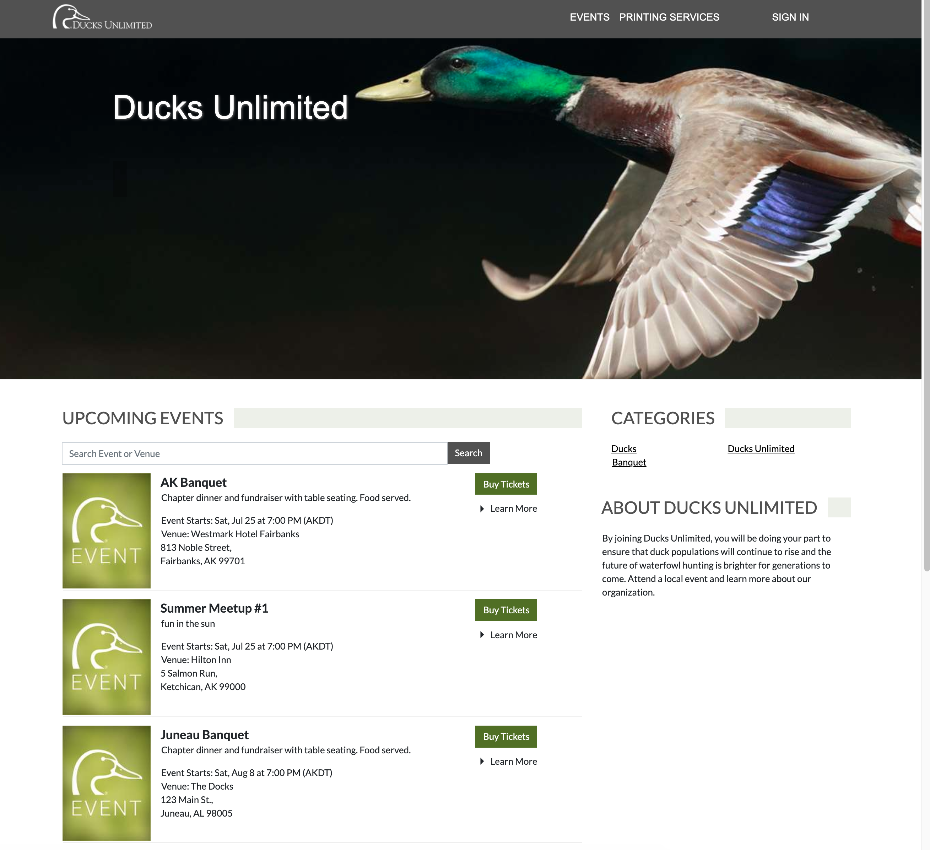



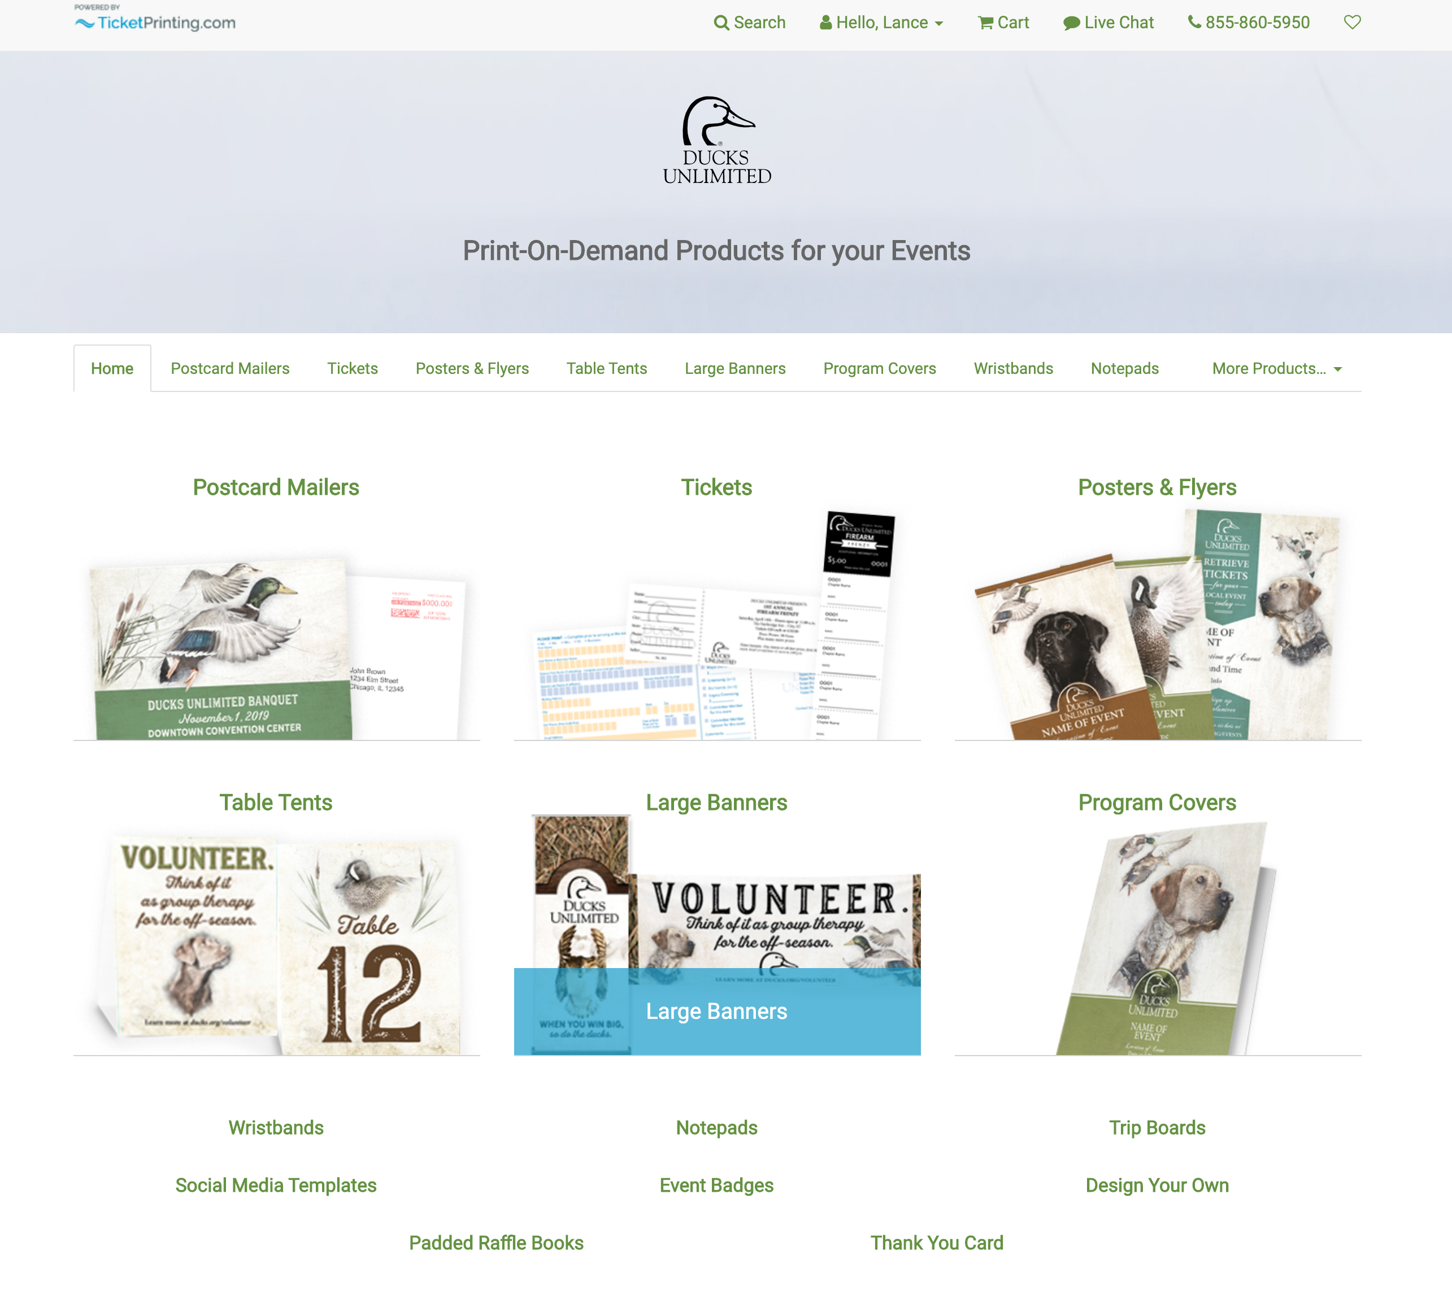



(private label Eventgroove)
Ducks Events Center
Ducks Fundraising
Ducks Products
RAFFLES
AUCTIONS
A-THONS
CROWDFUNDING
SALES
SWEEPSTAKES
.

